Slide 1

UNIT 2 : IoT Design Methodology
Ms. Lavanya Santhosh
Assistant Professor
Dept. of CSE
Dr.AIT

Slide 2
OUTLINE
Module 1
Introduction
IoT Design Methodology
Purpose & Requirements Specification
Process Specification
Domain Model Specification
Information Model Specification
Service Specifications
IoT Level Specification
Functional View Specification
Operational View Specification
Device & Component Integration
Application Development
Case study – Weather Monitoring
Module 2
Smart objects: The “Things” in IoT
Sensors
Actuators
Smart Objects
Sensor Network
Wireless Sensor Network
Communication Patterns
Communication Protocols for WSN

Slide 3
INTROduction
IoT systems involve interactions between various components such as IoT devices and network resources, web services, analytics components, application and database servers.
Difficult to evaluate the available alternatives.
They keep specific products/services in mind.
Adding new feature or redesigning becomes very complex and may require redesigning of the system.

Slide 4
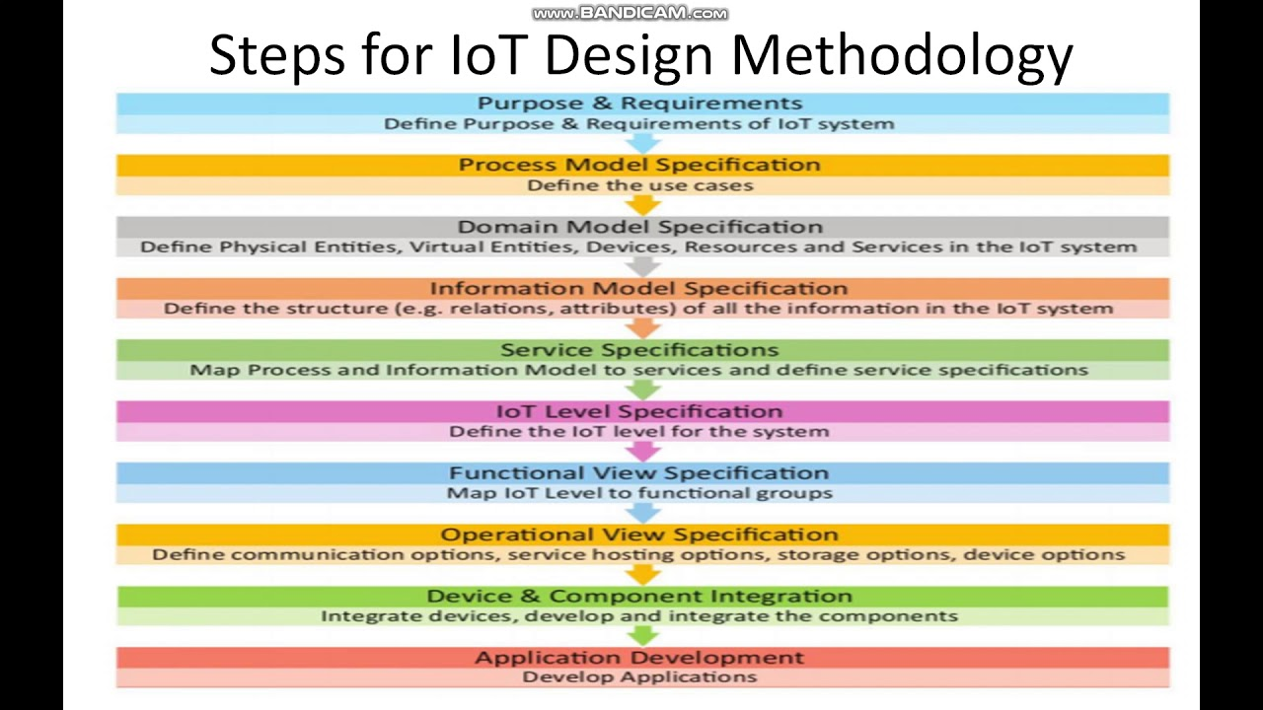
IoT Design Methodology

Slide 5
STEP 1: Purpose & Requirements Specification
The first step in IoT system design methodology is to define the purpose and requirements of the system.
In this step, the system purpose, behaviour and requirements (such as data collection requirements, data analysis requirements, system management requirements, data privacy and security requirements, user interface requirements) are captured.

Slide 6
Example : Smart iot based home automation system
Purpose: Controlling the lights remotely
Behaviour : Auto and manual mode
System Management requirements: remote monitoring and control functions.
Data collection & Analysis Requirement: Data collection & Local analysis of the data.
Application Deployment Requirement: Deployed locally on the device, but should be accessible remotely.
Security Requirement : Should have basic user authentication capability.

Slide 7
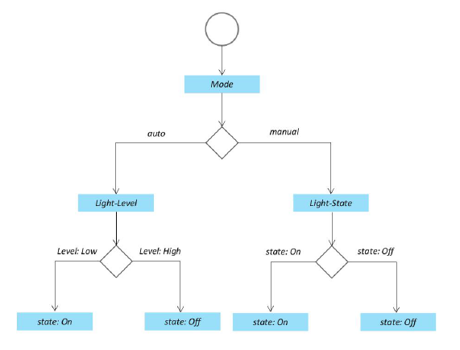
STEP 2: Process Specification
Formally described based on and derived from the purpose and requirement specification

Slide 8
STEP 3: Domain model Specification
The domain model describes the main concepts, entities and objects in the domain of IoT system to be designed.
Defines the attributes of the objects and relationships between objects.
Domain model provides an abstract representation of the concepts, objects and entities in IoT domain independent of any specific technology or platform.
With the domain model, the IoT system designers can get an understanding of the IoT domain for which the system is to be designed.

Slide 9
Example : Smart iot based home automation system
Physical Entity : room, a light, an appliance, a car etc
Virtual Entity: Representation of the PE in the digital world
Device: Medium of interaction b/w PE and VE.
Resource : Software components either “on-device” or “network-resource”.
Service : Provides the interface with PE

Slide 10
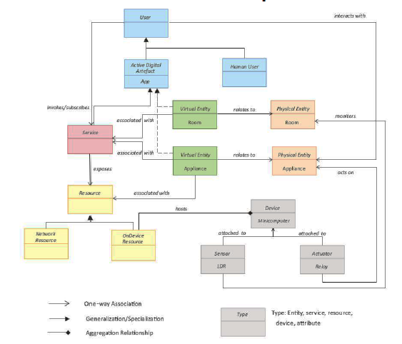
Example : Smart iot based home automation system

Slide 11
STEP 4: Information Model Specification
Defines the structure of all the information in the IoT system (Attributes of VE, relations etc)
Does not describe the specifics of how the information is stored or represented.
Adds more details to the virtual entities ( attributes and relations )

Slide 12
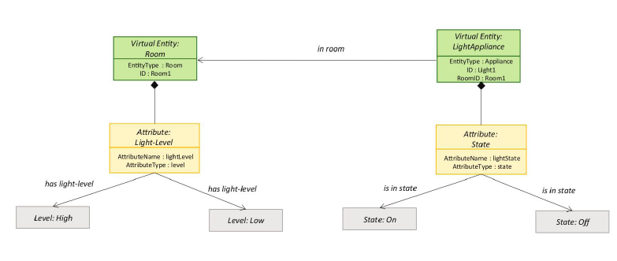
Example : Smart iot based home automation system

Slide 13
STEP 5: Service Specification
Defines the services in the IoT system like service types, service inputs/ output, service endpoints, service schedules, service preconditions, and service effects.
An endpoint is usually represented by a URL (Uniform Resource Locator) that points to where the service is hosted.
For example, in a smart home automation system, an endpoint for controlling the lights might be https://smarthome.com/api/lights

Slide 14
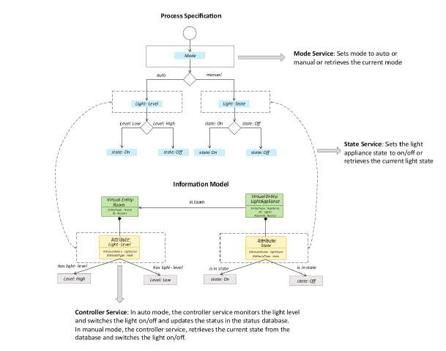
Deriving services for home automation IoT system

Slide 15
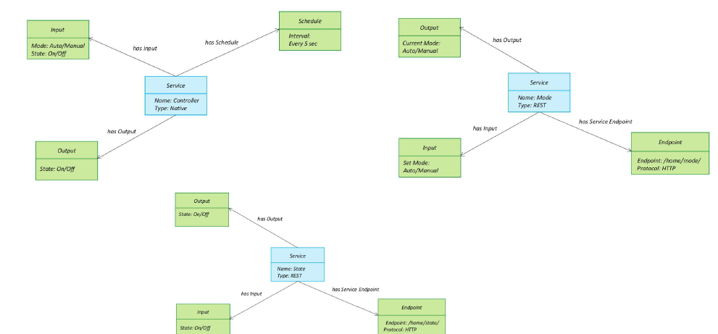
Services : Smart iot based home automation system

Slide 16
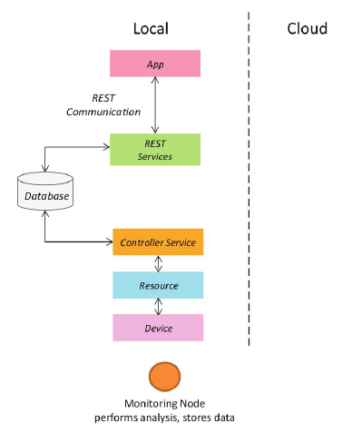
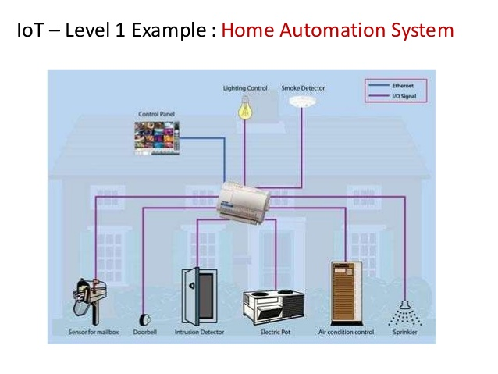
STEP 6: IoT Level Specification
Defines the IoT level for the system.
Deployment design of the home automation system.

Slide 17
STEP 7: Functional view Specification
Defines the functions of the IoT system grouped onto various functional groups.
The functional groups (FG) included in a functional view include:
Device
Communication
Services
Management
Security
Application

Slide 18
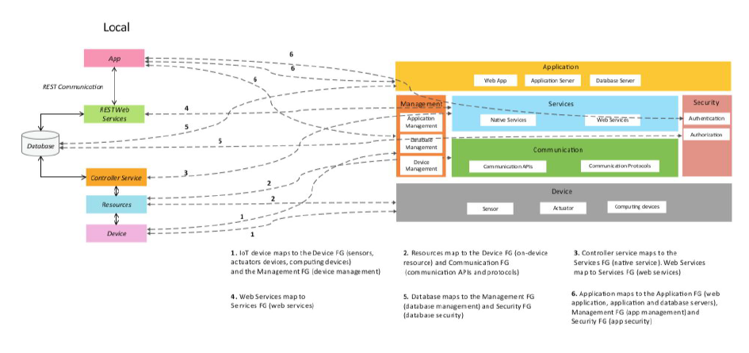
Mapping deployment level to FG’s for Home Automation IoT system.

Slide 19
STEP 8: operational view Specification
Defines the various options pertaining to the IoT system deployment and operations (service hosting options, storage options, device options, application hosting options).
Operational view specifications for the home automation examples are as follows
Devices: Computing device(Raspberry Pi), light dependent resistor(sensor), relay switch(actuator)
Communication APIs: REST API’s
Communication protocol: Link Layer, Network Layer, transport and Application Layer
Services Controller Service, State Service and Mode service
Application: Web App, App Server and DB Server
Security: Authentication and Authorization
Management: Application Management, DB and device management

Slide 20
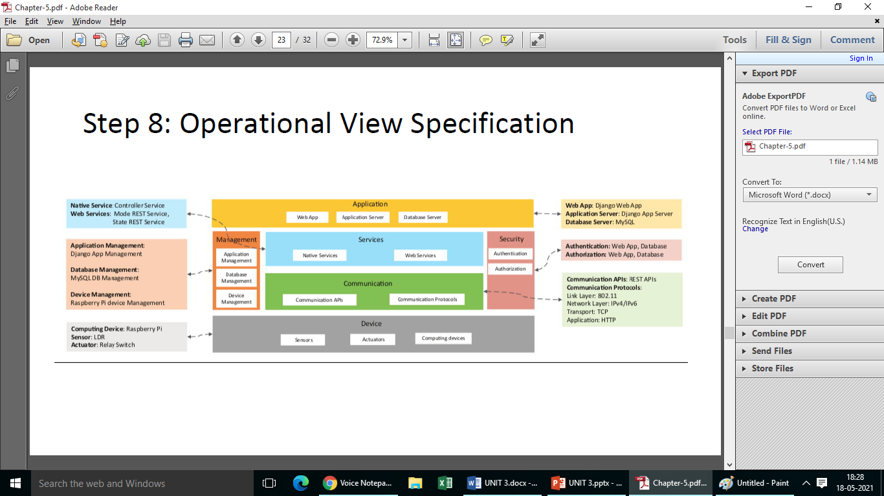
Mapping FG to operational view for home automation IoT system

Slide 21
STEP 9: Device and Component Integration
Defines the integration of the devices and components.
The devices and components used in this example are raspberry Pi minicomputer, LDR sensor and relay switch actuator.

Slide 22
STEP 10: Application Development
The final step in the IoT design methodology is to develop the IoT application.
The application has controls for the mode (auto on or auto off) and the light (on or off).

Slide 23
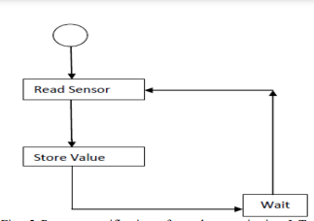
Case study : Weather Monitoring System
The purpose of the weather monitoring system is to collect data on environment conditions such as temperature, pressure, humidity and light in an area using multiple end nodes.
Figure : Process Specification for WMS

Slide 24
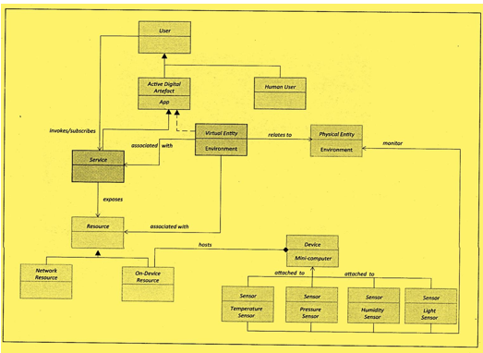
Case study : Weather Monitoring System – Domain Model

Slide 25
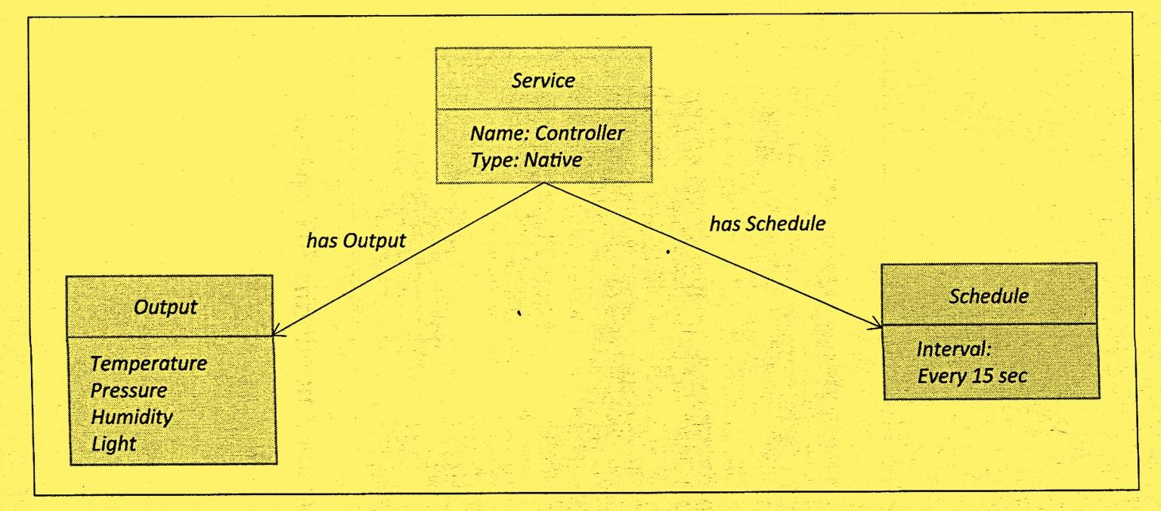
Case study : Weather Monitoring System – Controller service

Slide 26
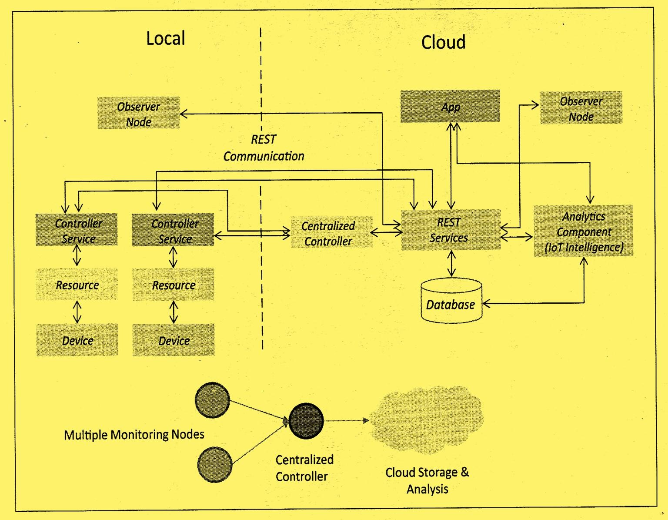
Case study : WMS – Deployment design for the system

Slide 27
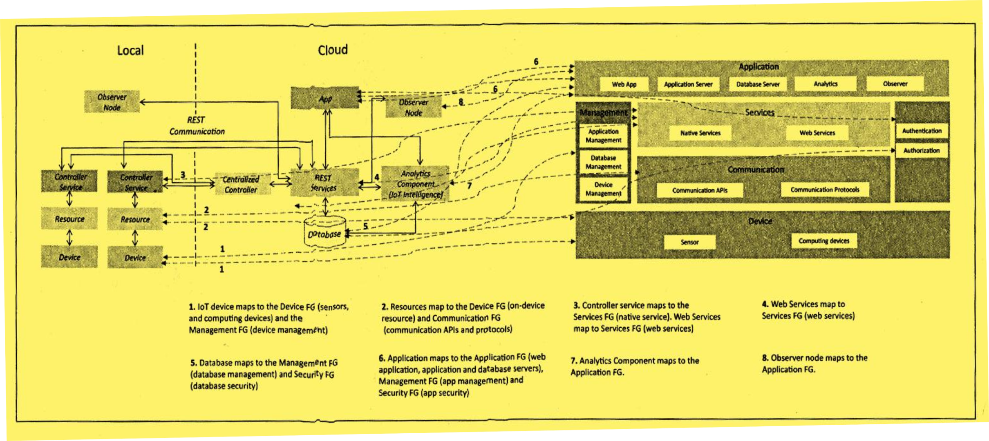
Mapping deployment level to functional groups for the weather monitoring system.

Slide 28
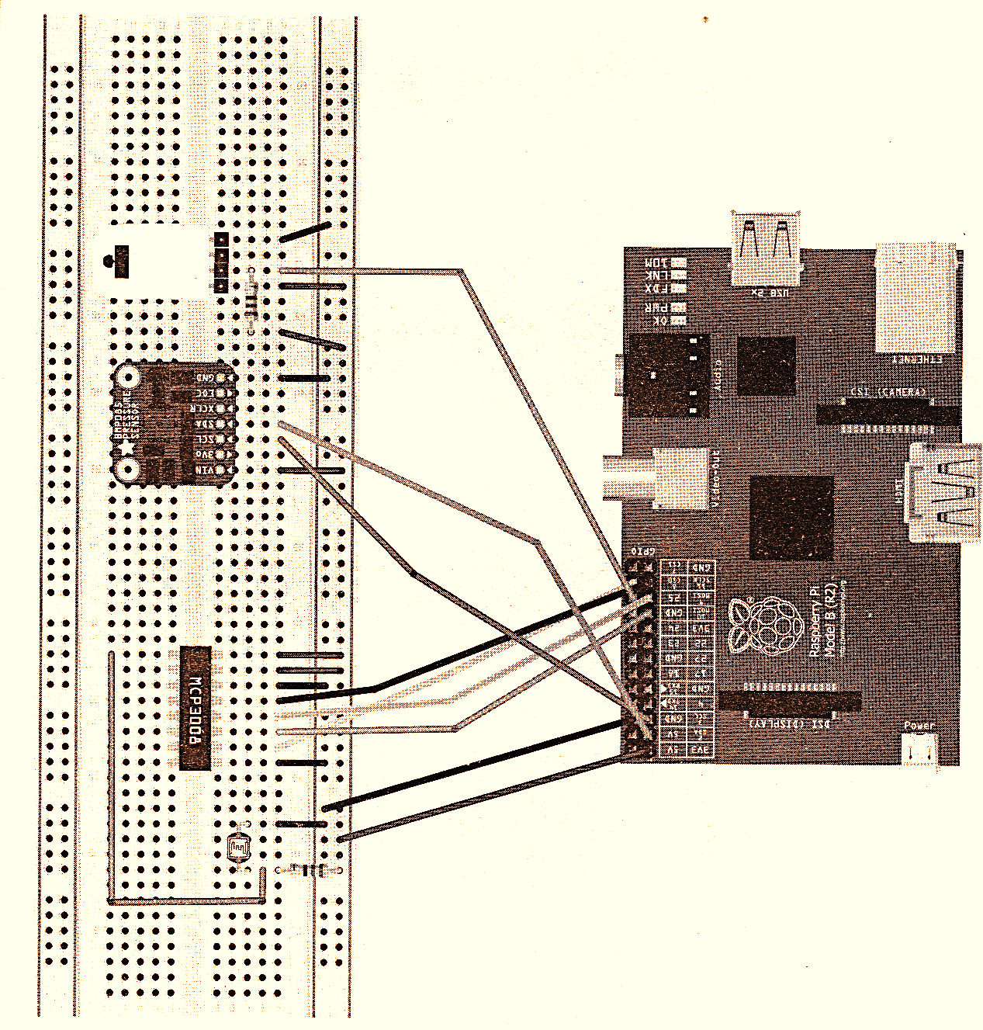
Schematic Diagram of the
Weather Monitoring System
The devices and components used in
this example are Raspberry Pi
mini computer, temperature sensor,
humidity sensor, pressure sensor
and LDR sensor.

Slide 29
Thank you

